Slide 1
PBL lesson
PARTICIPATE
BE IN CLASS, EVERY DAY, EVERY LESSON

Slide 2
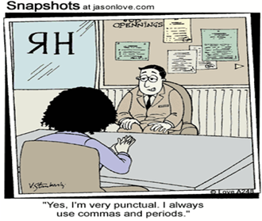
Learning intent:
Students will understand the importance of being IN CLASS, EVERY DAY, EVERY LESSON
Success Criteria:
Identify the reasons why we need to be in class, every day, every lesson
Identify the cause and effects in the scenarios
Vocabulary:
Punctual

Slide 3

What do we mean by punctual?
In class on time, lined up, waiting to enter the classroom
Ready to learn with all our equipment
Have finished eating
Have been to the toilet, had a drink (or have a water bottle filled)

Slide 4

Why?
You disturb the learning of other students by interrupting, leaving the room, returning
Outside of school, your work may limit your breaks or access to facilities might be limited. Therefore it is important to practice being prepared
You miss important messages, information and class tasks.
Arriving 5 minutes late to one lesson a day equates to 50 minutes over the course of a term.
Which is a total of more than 3 hours of school missed per year
Seniors- being constantly late or out of class will be reflected on your School Reference. This could impact your future employment.

Slide 5

So what? Why does it matter?

Slide 6
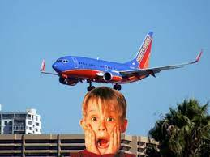
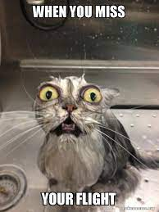
Scenario 1- airport
The check-in for your flight is at 09:00 and you arrive at 09:15 because you slept in
What do you think will be the outcome of not being on time?

Slide 7
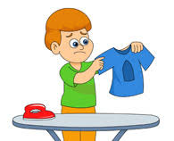
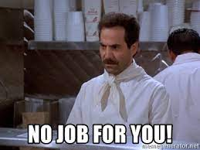
Scenario 2- job interview
You have a job interview at 15:00 and you arrive at 15:07 because you did not get your clothes ready the night before and had to iron your shirt
What do you think the response will be from your prospective employer?

Slide 8
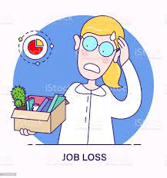

Scenario 3- workplace
Your Saturday morning shift starts at 7:00, but the last 3 Saturday’s you have slept in because you have been up until 2am.
Your boss has had to cover for you each Saturday while waiting for you to arrive
What do you think the outcome of this continued behaviour will be?

Slide 9
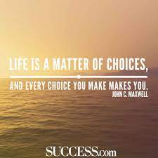
What positive things can you do to be in class every day, every lesson?
Get your school bag ready the night before
Know your timetable and where your classes are
Move to class when the first bell goes
Fill your water bottle up at first or second break

Slide 10
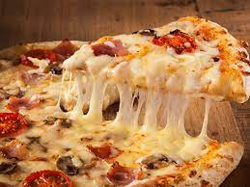
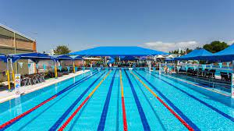

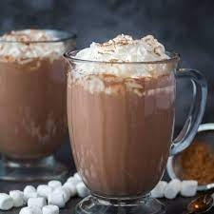


Positive choices = positive rewards

