Slide 1
PBL FOCUS LESSON – Term 2, Week 7, 8 & 9
Stay on task & be an independent and resilient learner

Slide 2
PBL Lesson – Term 2, Week 7
Students will understand what it means to stay on task and be an independent and resilient learner.
Define Independent & Resilient
Understand the impact of staying on task
Identify strategies to build resilience
Independent, resilient

Slide 3

Independent Learner
Students who can take responsibility for their own learning, take initiative and make good decisions.
Independent Learners show…
curiosity, passion, inspiration, discernment, self-motivation, self-examination, accountability, critical thinking and persistence

Slide 4
Resilient
able to withstand or recover quickly from difficult conditions.
Synonyms | Antonyms
strong adaptable tough quick to recover flexible | inflexible vulnerable crumble flaky

Slide 5
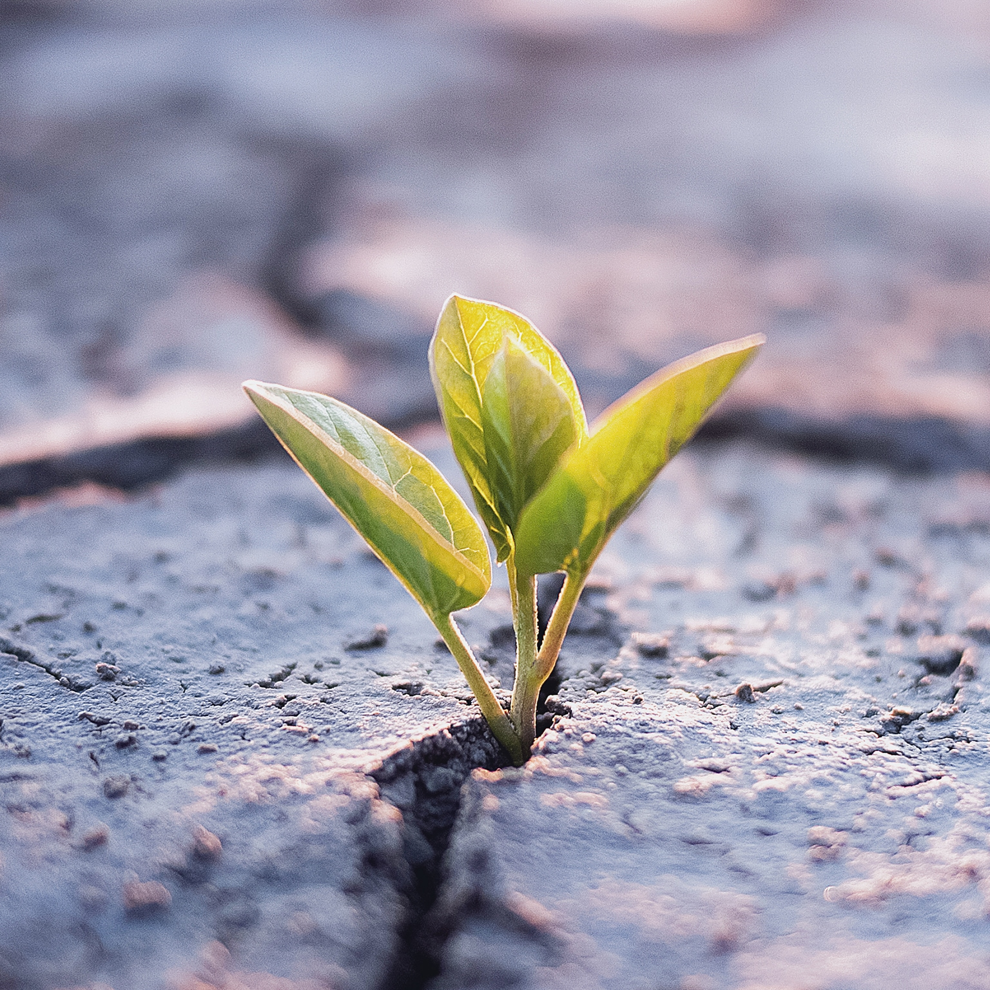
Being resilient means…
Being able to handle difficult situations
The ability to “bounce back” from hardship
Not seeing failure as final
Persevering to reach a goal
Being able to face difficulties head on
Keeping cool under pressure
Having a “fighter”, not “victim”, mentality
Taking control when facing adversity

Slide 6
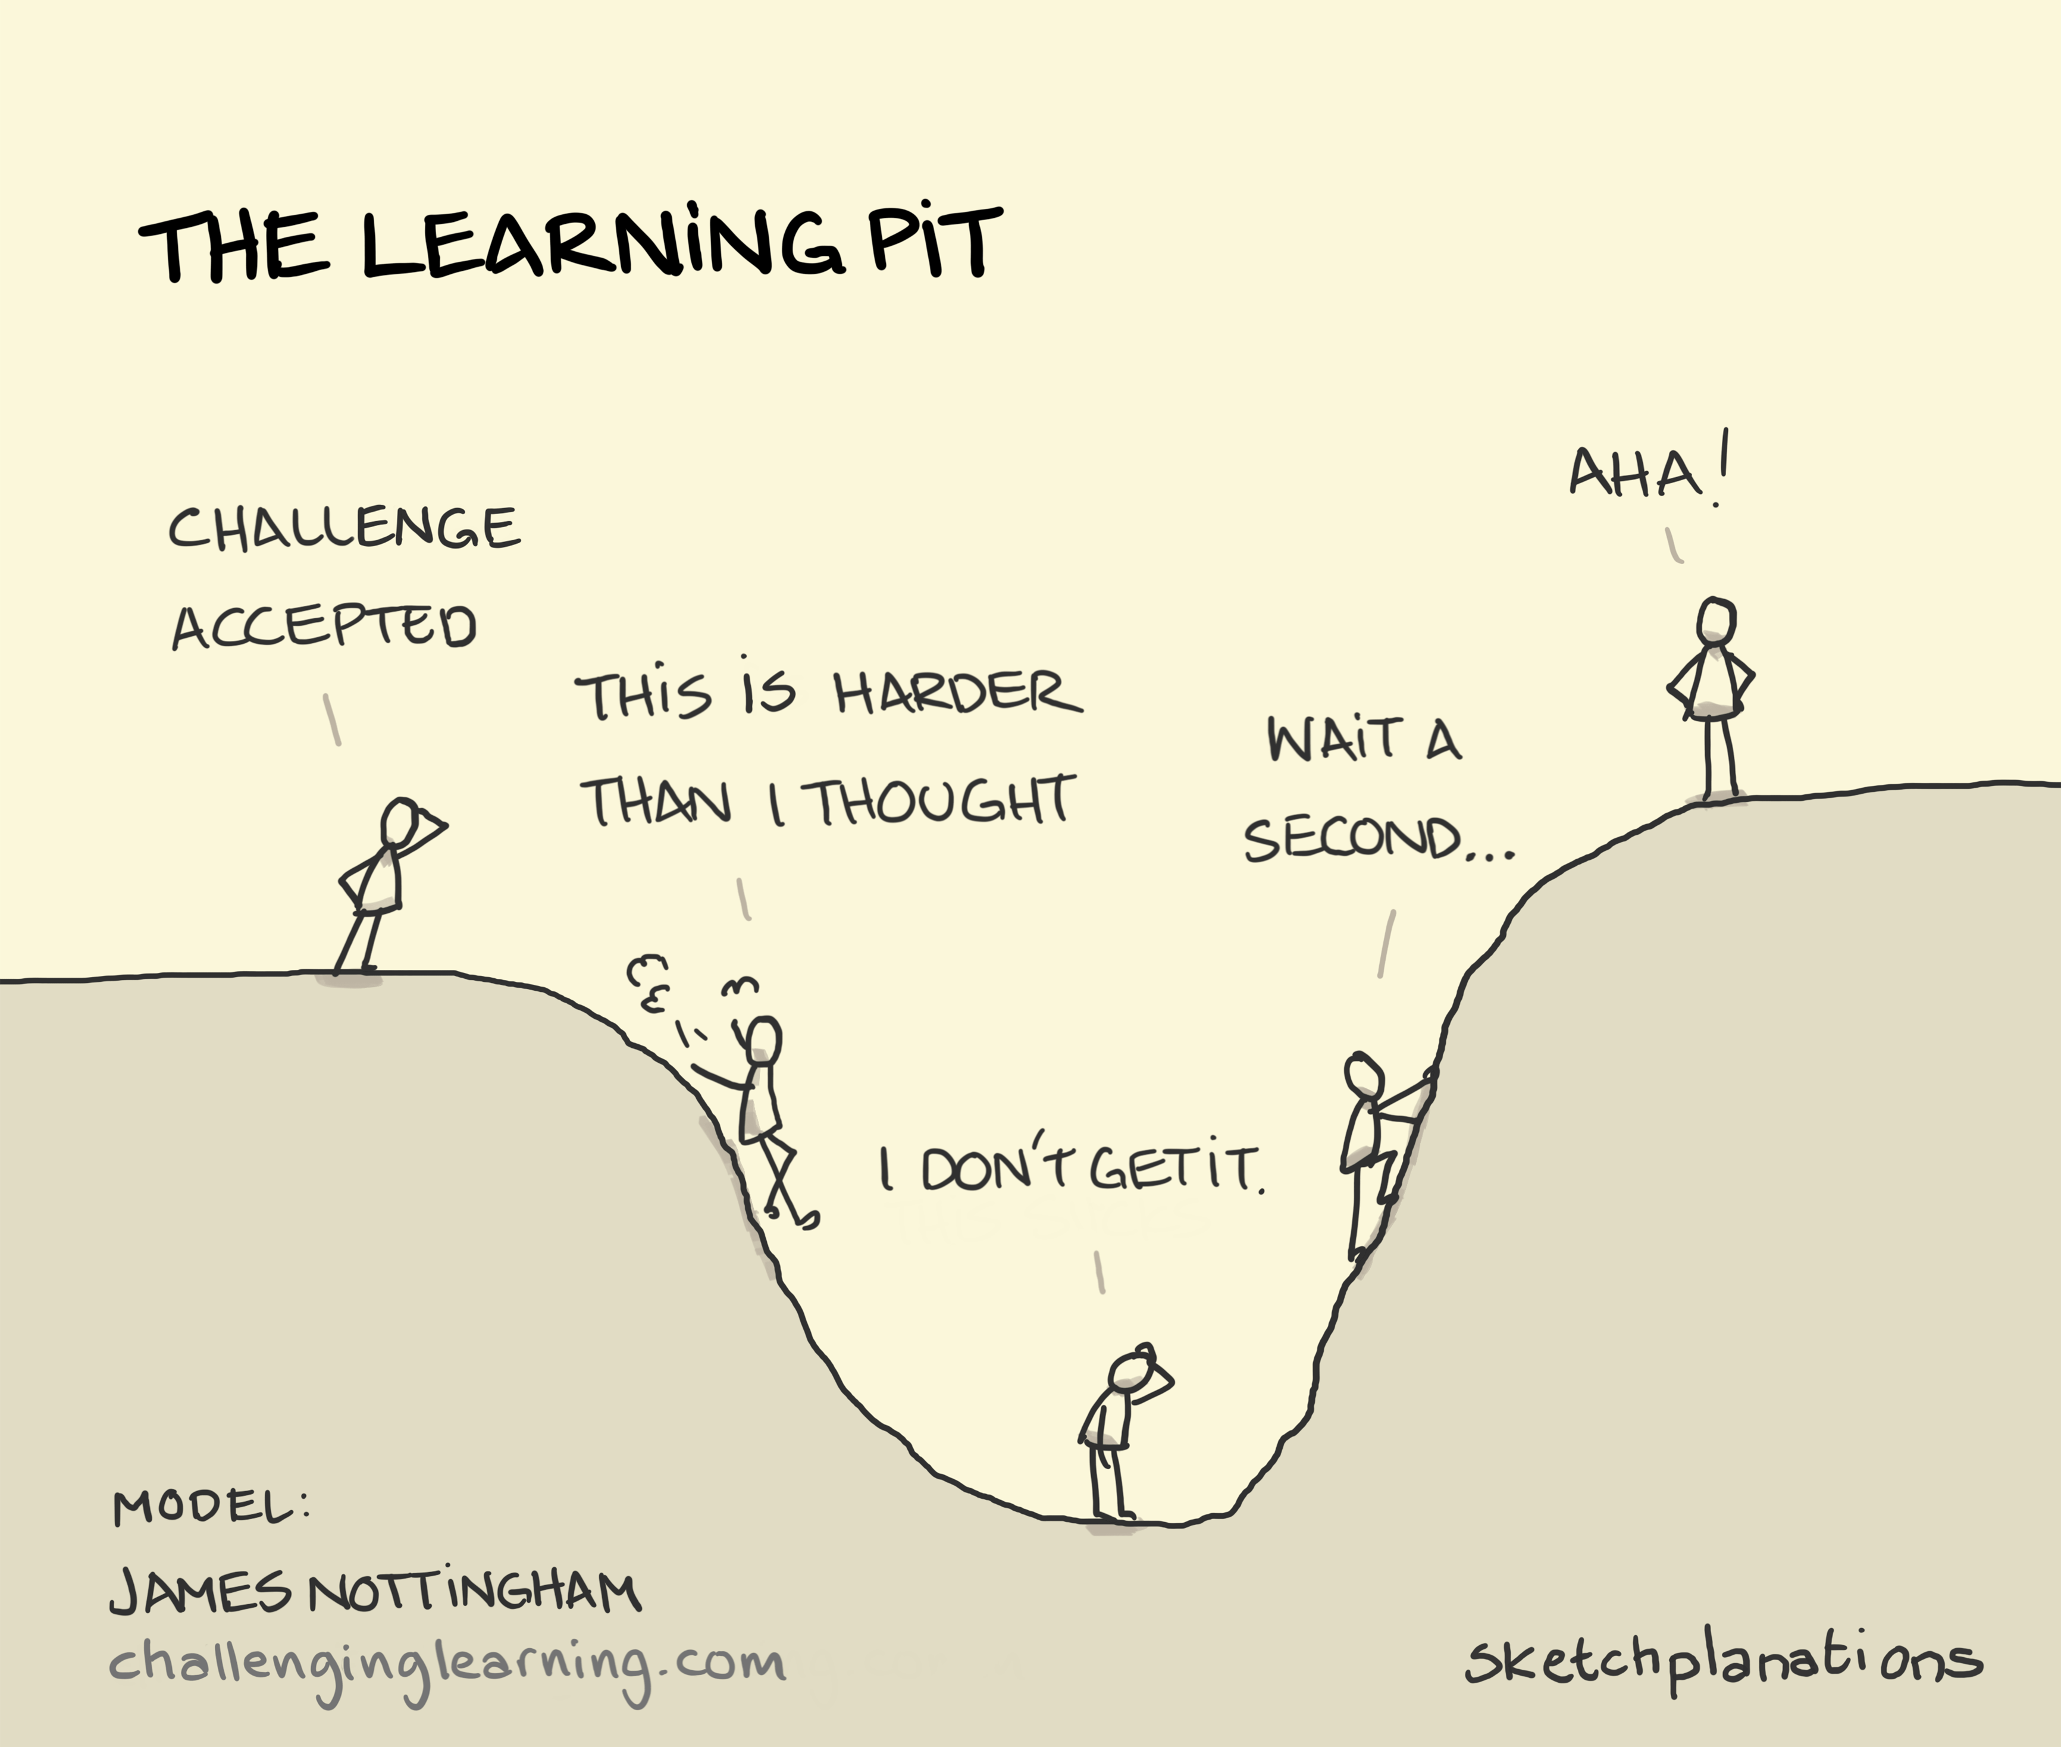
Resilience!

Slide 7
What would a RESILIENT student do?
Frankie has been given a Maths exam. The rest of his class is working quietly on the exam and his teacher is supervising. A teacher aide is working with other students.
Frankie quickly realises that he does understand much of what is on the exam. He pushes it to the side and starts tapping his pen. Bored, with nothing to do, he starts trying to get his friend’s attention.
Does Frankie show resilience?
What could Frankie do differently?
Reflect: What would you do? Could you do something different?

Slide 8
What would a RESILIENT student do?
Does Coco show resilience?
Coco has just gotten into trouble for speaking with her friends, instead of completing her work in class.
Her name is the only one written on the board for this behaviour. She now refuses to complete any work as the teacher is not being fair.
What could Coco do differently?
Reflect: What would you do? Could you do something different?

Slide 9
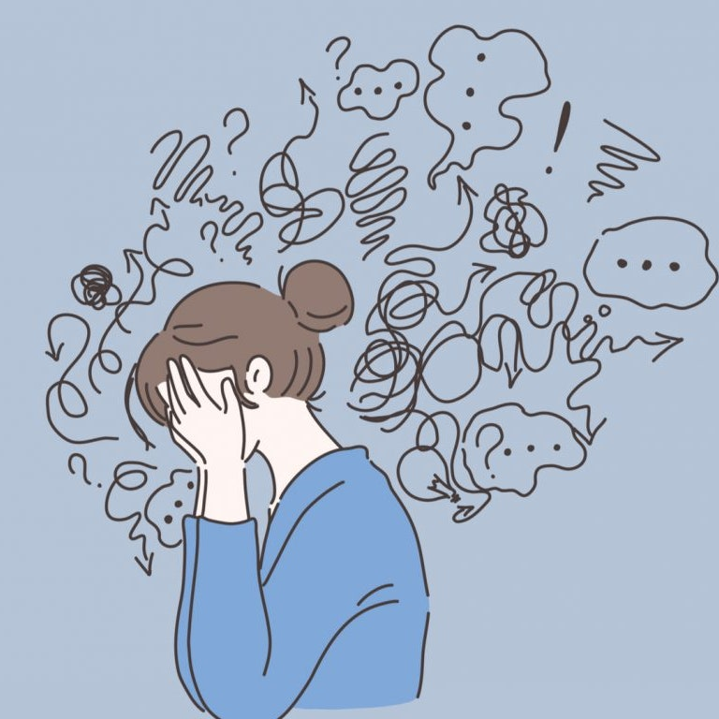
It is hard to be resilient when you are feeling overwhelmed
What are some strategies that might help you ground yourself, so you can overcome the problem?

Slide 10
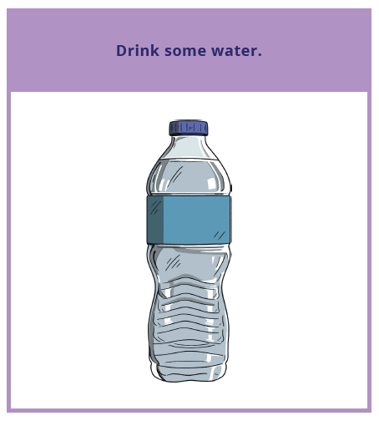
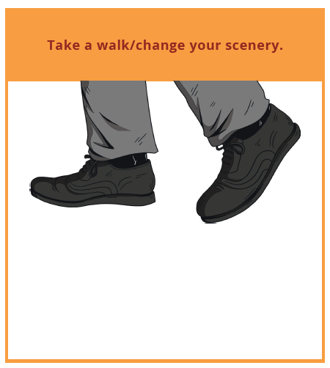

Slide 11
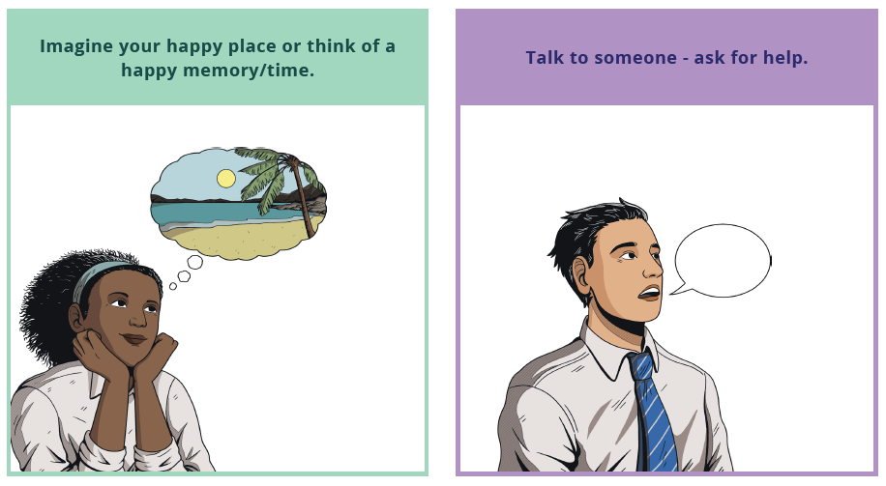

Slide 12
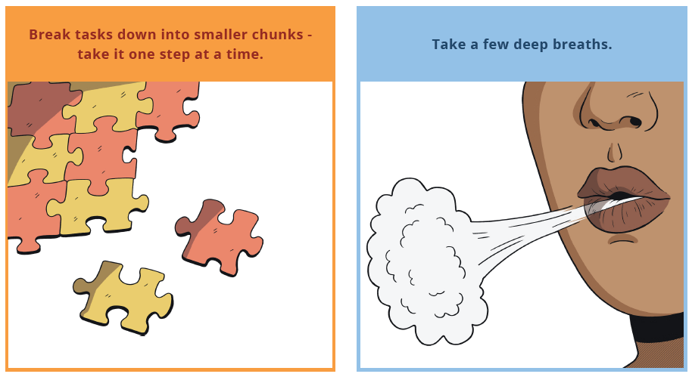

Slide 13
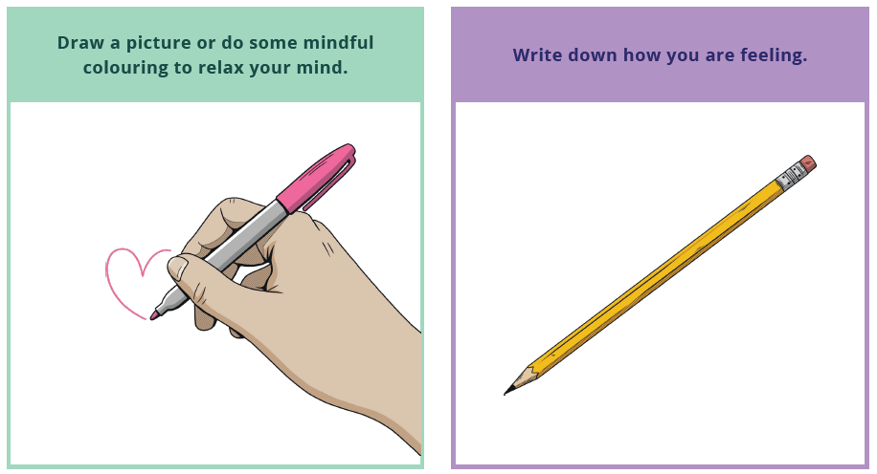

Slide 14

We only get more resilient by working through strategies and adding them to our ‘tool box’
Pick ONE strategy and make a commitment to yourself to try using it the next time you feel overwhelmed

