Slide 1
PBL PREPARED

Slide 2
Week 3 and 4 Focus
Learning Intent
Students will understand what polite and impolite language is and sounds like.
Success Criteria
Identify both polite and impolite language.
Describe how it makes you feel.
Specialised Vocabulary
Polite, impolite, respectful, disrespectful.

Slide 3
WHY?
Safe Classrooms
By keeping language polite and respectful, we help to keep the classroom safe and happy.
Future Prep
By using respectful language at school we learn how to speak to others appropriately in real world situations.

Slide 4
Heads (Polite) or tails (IMPOLITE):
A series of statements will be read out. If you think that statement is polite, put your hand on your head, if you think it is impolite, put your hands on your hips.
Raising your hand
Talking over someone else
“Shut up, Sir is talking!”
Grabbing another friend’s belongings
“Excuse me Sir”
Ignoring an instruction/ not responding
“I want to go to the toilet.”
Taking off your hat before you go inside
“Hey miss I need your help!”
“What are we doing?”
“I can’t do it”

Slide 5

SCENARIO
You and your friends are having lunch and you are all chatting to each other. You think of a funny story and want to tell your friends but you keep getting interrupted. You get mad a yell “Can you shut the F* Up!?”
Do you think this method is a polite way to start a story?
Who has been affected by your actions?
What choice could you make next time?

Slide 6
SCENARIO
You are bad day, you forgot your lunch. You have entered the classroom and teacher says “Sit down and get started”
“Don’t tell me what to do”
“you need to follow instructions”
“Or what” and walk away
Do you think this method is a polite way to start a story?
Who has been affected by your actions?
What choice could you make next time?

Slide 7
Consequences
Choosing to swear in the classroom or in the school grounds will result in negative consequences that can include suspension from school. Your teacher will determine the consequence based on the situation.
Choosing to swear AT a member of staff is very likely result in suspension from school
Positive consequences include learning how to express yourself more effectively and people will like you more and be more likely to help you.
Building respectful relationships with students and teachers.

Slide 8
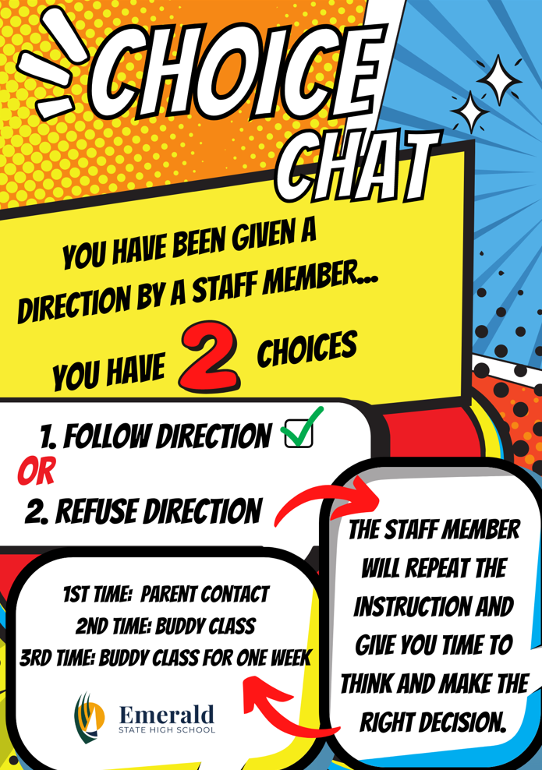

Slide 9
Review
By using respective language students are demonstrating that they are willing to building good and lasting relationships with others.
By using respective language students , students are developing the skills that will help them when they enter the workforce.

