Slide 1
PBL POLITE

Slide 2
Week 5 and 6 Focus
Learning Intent
Students will understand the importance of looking out for others
Success Criteria
Identify how bystander behavior can have a negative impact
Specialised Vocabulary
Polite, safe, bystander

Slide 3
WHY?
Look out for others
Irrational bystander behaviour amplifies the negative behaviour occurring
Future Prep
We need to understand the implications of our behaviour in order to avoid being guilty by association

Slide 4
What is a bystander?
Bystander:
Someone who sees inappropriate behaviour happening to someone else
Positive bystander:
Someone who takes safe action to help the target of the behaviour
Negative bystander:
Some bystanders might also get involved in the inappropriate behaviour, for example, taking photos, sending texts, posting content on social media that show the behaviour

Slide 5
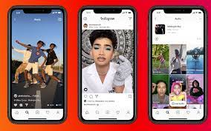


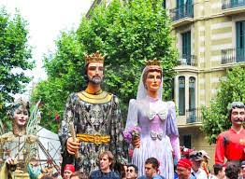
There is no king or queen without their subjects…
A person’s power is due to the complicity of their ‘subjects’- the many individuals willing to support and empower that particular person
Think about a celebrity and how their ‘power’ comes from the support of their ‘followers’
If a celebrity loses their fans, they lose their power
If we do not act as a negative bystander, the behaviour will cease

Slide 6

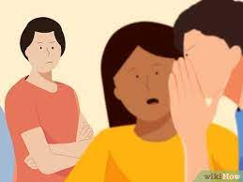
SCENARIO- part a
Emily wants to post a rumour that Suzanne likes Ben even though she is dating Jack, Emily’s friends’ Sarah and Rose go along with Emily, even though they think it’s a bad idea
Describe how this behaviour was not helpful to the targets- Suzanne, Jack and Ben
Who has been affected by these actions?
Would this be considered positive or negative bystander behaviour?

Slide 7
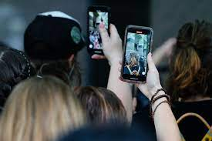
Scenario- part b
Is filming the fight positive or negative bystander behaviour?
What might Sarah and Rose have done differently?
How could you handle a similar event that seems harmless in the beginning?
Jack confronts Ben at school the next day about the rumour and a physical fight breaks out. The fight is recorded by bystanders and uploaded to social media

Slide 8
Positive bystander tips
Speak out against the behaviour, seek the support of a trusted adult
If you don’t feel safe speaking out against the instigator, take evidence (screenshots or photos) to a trusted adult and ask them for help
Don’t encourage the behaviour- walk away, don’t comment on a post
Report the behaviour or allegations to a trusted adult/ police/ anonymously if you don’t feel safe
Show empathy- imagine if it was you who was the target, how would you feel?

Slide 9
Consequences
Choosing to engage in negative bystander behaviour could have negative consequences- guilty by association
Engaging in negative bystander behaviour could result in you being suspended from school and or in trouble with the police
Engaging in positive bystander behaviour can reduce unsafe behaviour around the school
Choosing to engage in positive bystander behaviour can help to build respectful relationships with students and teachers

Slide 10
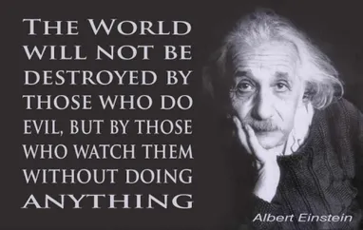
Review
By being aware of bystander behaviour we can ensure we look out for others and contribute to a safe school environment

