Slide 1
PBL Community Focus
Showing respect in the community

Slide 2
Learning intent: Students will understand why it’s important to be respectful in the community
Success Criteria:
List why it is important to respect other people
Explain why it would be important to always be respectful in the community
Vocabulary:
Respect

Slide 3
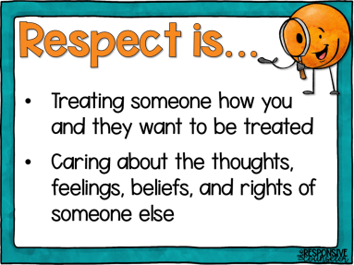
What is respect?

Slide 4
Why is it important to show respect in the community?
Receiving respect from others is important because it helps us to feel safe and to express ourselves.
Being respected by important people in our lives growing up teaches us how to be respectful toward others.
Respect means that you accept somebody for who they are, even when they’re different from you or you don’t agree with them.
Respect doesn’t have to come naturally – it is something you learn.

Slide 5
How can you be respectful in the community?
Smile
Say please and thank you
Be positive towards people you meet- there is no need to share negative comments
Making sure you’re silent when the National Anthem is playing
If you are running late and the National Anthem is playing, do not walk in during the middle of it. Wait until it’s over.
Acknowledge diversity- you may not agree with what people are saying, but you don’t need to make comments about it.
Respect can have a ripple effect. If you’re respectful, others will be respectful back.

Slide 6
How else can you show that you’re showing respect in the community?
Pick up your rubbish
If you are eating somewhere, make sure your area is clean before you leave it.
If you see rubbish lying around- pick it up.
Recycle
Push your chairs in before you leave a table you are sitting at.
If a place looks like it has been respected, it will be a much happier area to be and others will want to look after it.

Slide 7
Respect also counts on the sporting field
Wear your uniform with pride
Be a good sport
Play your game- don’t disrespect the opposition
Don’t argue with the referee/umpire- they’re trying their best too
Shake opposition hands at the end of the game
Thank the ref
Support your team- celebrate the successes during and after the game

Slide 8
Don’t forget to have respect for yourself as well!
Being respectful toward others is one part of the puzzle. It’s also important to have respect for yourself.
Remember that you are valued and you matter.
What you think and feel is just as important as what somebody else thinks and feels.
Ending a relationship that isn’t respectful is a way of respecting yourself.

Slide 9
