Slide 1


Slide 2
Expectations at ESHS
Students will understand the expectations around being in class every day, every lesson and routines at ESHS.
Understand and be able to recall all key expectations
Be able to demonstrate how to follow the routines and expectations
Polite, Prepared, Participate

Slide 3
WHY?
School
To ensure you are:
Not falling behind in class
Staying up to date with assessment
Getting notices, so you do not miss out on extra curricular/curricular information.
Future Prep
To ensure you are:
Holding down a job, as showing up to work each day is an expectation
Not missing out on your pay/wage.

Slide 4
School Application:
1 or 2 days a week doesn’t seem much but…
If you miss… | That equals… | which is… | And over 6 years of high school that’s… | Which mean the best your might perform is…
1 day per fortnight | 20 days per year | 4 weeks | 24 weeks, which is = Over half a year | Equal to finishing half way through year 12.
1 day per week | 40 days | 8 weeks | 48 weeks = Over 1 year | Equal to finishing in Term 4, Year 11
2 days per week | 80 days | 16 weeks per year | 96 weeks = almost 2.5 years | Equal to finishing halfway through year 10.
3 days per week | 120 days per year | 24 weeks per year | 144 weeks = over 3.5 years | Equal to finishing halfway through year 9.

Slide 5
Future Application: Going to Work
Median Australian Salary Wage is $57,200
Equals: $1100 per week in pay
If you miss… | That equals… | which is…. | Which means you are missing out on…
1 day per fortnight | 24 days per year | Approximately 4 weeks of no pay | $1100 x 4 = $4400
1 day per week | 48 days | Over 9 weeks of no pay | $1100 x 9 = $9900
2 days per week | 96 days | 19 weeks per year of no pay | $1100 x 19 = $20900
3 days per week | 144 days per year | Over 28 weeks per year of no pay | $1100 x 28 = $30800

Slide 7
time
hats
equipment
neatly
permission
quiet
behind
graffiti
diary
pen

Slide 8
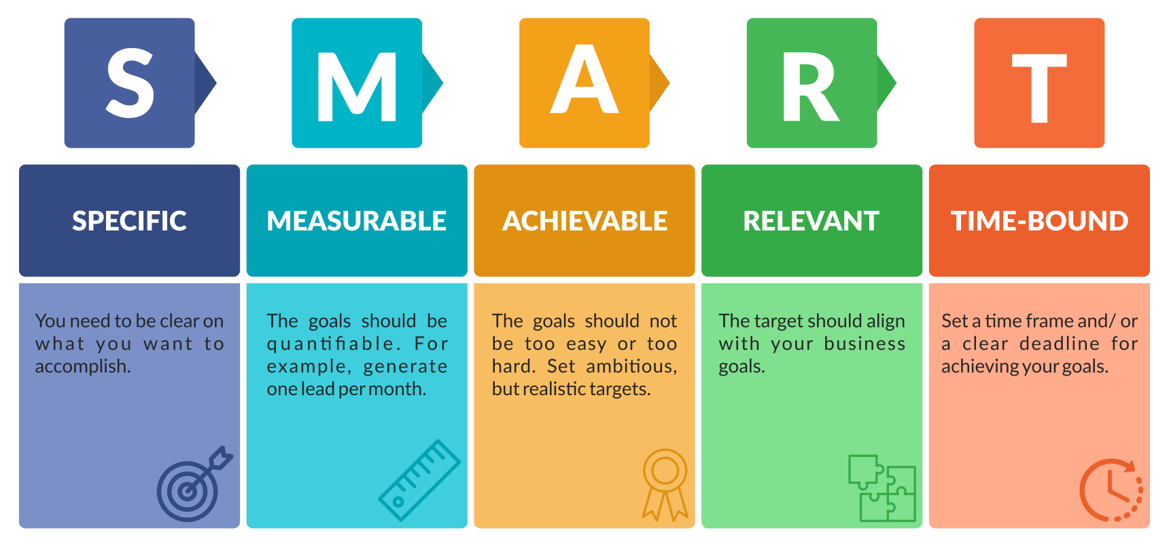

Slide 9
SMART Goals
You are going to set 3 goals for yourself for Term 4
An academic goal
A behaviour goal
A personal goal
When you are finished, place the paper in the clear sleeve in your diary

Slide 10
Smart Goal Ideas
Academic | Behaviour | Personal
Is there a subject you’d like to do better in this semester? Improve your bookwork Improve attendance Complete all homework Ensure all work is completed to the best of your ability Raise hand more in class | Arrive at school before PC Getting to class on time Bringing all of your equipment to every class Wearing to correct uniform Bring diary every day | Make new friends outside of your class group Get involved with a club at school Try a new sport Read more books Have a quality night sleep Reduce screen time

Slide 11

One Word Check-Out
Go around the class and use ONE WORD to describe how you are feeling after today’s lesson

